Slide 1

Note: The data and information in this document is reflective of a hypothetical situation and client. This document is to be used for KPMG Virtual Internship purposes only.
Sprocket Central Pty Ltd
Data analytics approach
[KPMG] - [EKOH STELLA], [Junior Consultant]

Slide 2
Note: The data and information in this document is reflective of a hypothetical situation and client. This document is to be used for KPMG Virtual Internship purposes only.
Agenda
Introduction
Data Exploration
Model Development
Interpretation

Slide 3
Note: The data and information in this document is reflective of a hypothetical situation and client. This document is to be used for KPMG Virtual Internship purposes only.
Introduction
IDENTIFYING AND RECOMMENDING HIGH VALUE CUSTOMERS.
PROBLEM
Spyrocket Central is a company that specializes in high quality bike and accessible cycling accessories to riders.
The marketing team is looking to boost by analyzing their existing customers dataset to determine customer trend and behavior.
To target 1000 new customers that will bring highest value to the organization.
APPROACH FOR DATA ANALYSIS
Bike related purchases for the last 3years based on gender.
Top industries contributing maximum profit based on bike related sales.
Wealth segment by age category
Number of cars owned in each state.
Customer classification.

Slide 4
Note: The data and information in this document is reflective of a hypothetical situation and client. This document is to be used for KPMG Virtual Internship purposes only.
Data Exploration
DATA QUALITY ASSESSMENT
These are the key issues analyzed for the data quality assessment

Slide 5
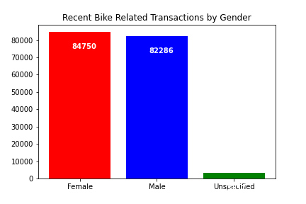
Note: The data and information in this document is reflective of a hypothetical situation and client. This document is to be used for KPMG Virtual Internship purposes only.
Data Exploration
Bike Related Purchase Over The Last 3years Based On Gender
The data shows that on average females have made more bike related purchases in the last 3years compare to male

Slide 6
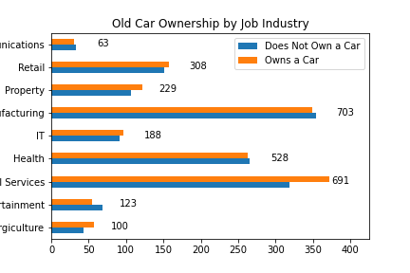
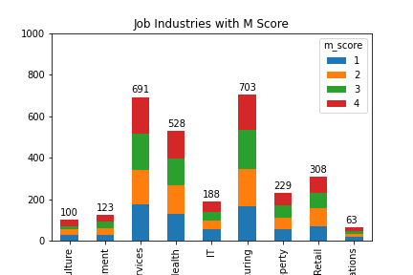
Note: The data and information in this document is reflective of a hypothetical situation and client. This document is to be used for KPMG Virtual Internship purposes only.
Data Exploration
Top Job Industry Contributing The Highest Profit and Bike Related Purchases
The top 3 industries bringing in highest profit as shown in the chart are Manufacturing, Financial Services and Health.
These industries are based within the city or on the outskirt of the city therefore most consumers prefer bikes for commuting.
Place any supporting images, graphs, data or extra text here.

Slide 7
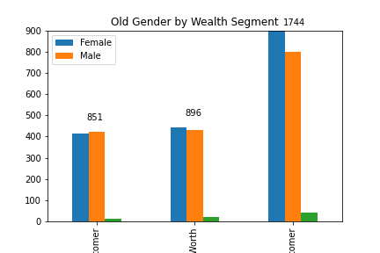
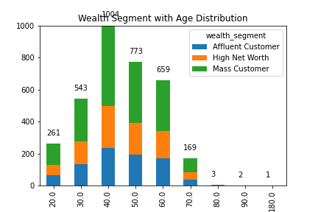
Note: The data and information in this document is reflective of a hypothetical situation and client. This document is to be used for KPMG Virtual Internship purposes only.
Data Exploration
Profit Of Wealth Segment By Age
Mass customers between the age of 40-49yrs are more likely to bring the highest profit for the company compared to other age class.
Also, the mass customer segment makes the highest profit across all the different age class.
This indicates a trend of buying power, as the buying power increases over time till 49years and then you will see a decline in buying power, thus leading to low profit.
Place any supporting images, graphs, data or extra text here.

Slide 8
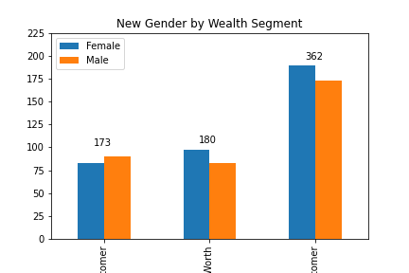
Note: The data and information in this document is reflective of a hypothetical situation and client. This document is to be used for KPMG Virtual Internship purposes only.
Data Exploration
Place any supporting images, graphs, data or extra text here.

Slide 9
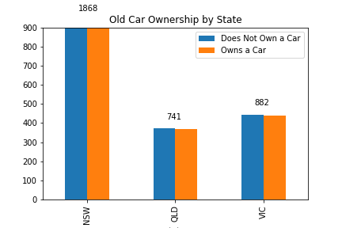
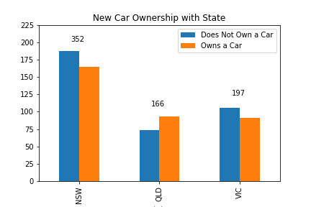
Note: The data and information in this document is reflective of a hypothetical situation and client. This document is to be used for KPMG Virtual Internship purposes only.
Data Exploration
Number Of Cars Owned In Each State
NSW has the highest potential number of people who do not own a car as equal to the number of people that own cars, which shows that there is opportunity to find value customers there.
NSW, QLD and VIC could be potential market opportunity for the company.
Place any supporting images, graphs, data or extra text here.

Slide 10
Note: The data and information in this document is reflective of a hypothetical situation and client. This document is to be used for KPMG Virtual Internship purposes only.
Interpretation
Classification- Targeting High Value Customers
These are the high valued customers that should be targeted from the new list:
Those are currently living in NSW and VIC.
People between the age of 40-49years.
Those working in the manufacturing, financial services and health sector industry.
Most of the high valued customers will be female compare to male.

Slide 11
Note: The data and information in this document is reflective of a hypothetical situation and client. This document is to be used for KPMG Virtual Internship purposes only.
Appendix

Slide 12
Note: The data and information in this document is reflective of a hypothetical situation and client. This document is to be used for KPMG Virtual Internship purposes only.
Appendix
This is an optional slide where you may place any supporting items.

